Slide 1
Statistics & Bootstrapping
Part 1

Slide 2
Population: is everyone/everything in a group of interest.
Sample: subset (smaller group) of the population.
Probability Distribution: it’s a function that describes the possible values and likelihoods that a specific random variable can take.

Slide 3
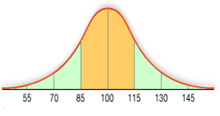
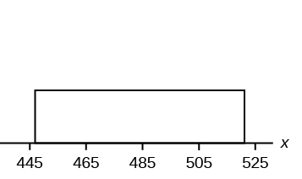
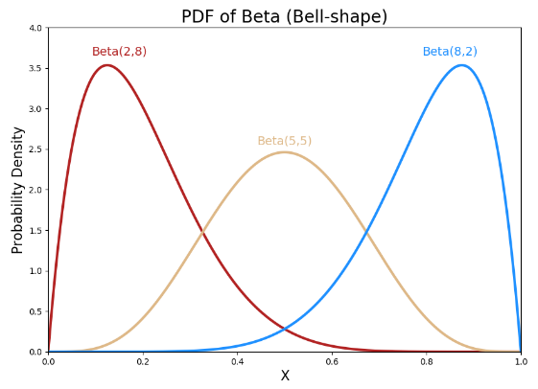

Slide 4
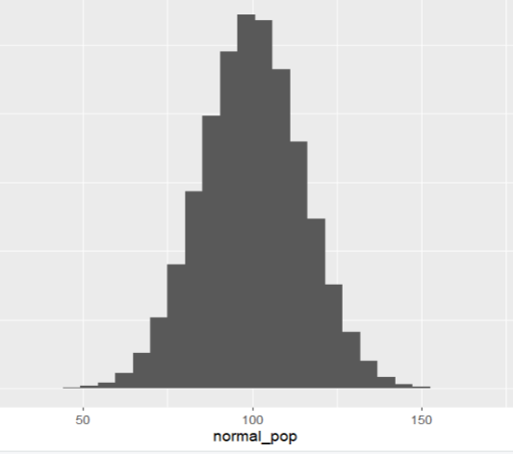
Creating a Population
Normal Distribution: Mean 100, Standard deviation 15.
N <- 1000000
normal_pop <- rnorm(N, mean = 100, sd = 15)
plot_1 <- data.frame(normal_pop) %>%
ggplot(aes(normal_pop))+
geom_histogram()
plot_1

Slide 5
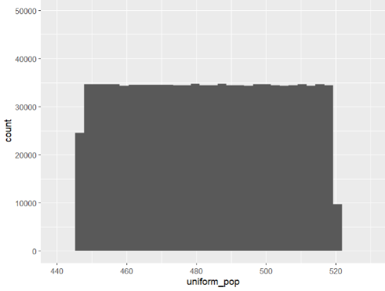
Uniform: min = 446, max = 520
N <- 1000000
uniform_pop <- runif(N, min = 446, max = 520)
plot_2 <- data.frame(uniform_pop) %>%
ggplot(aes(uniform_pop))+
geom_histogram()
plot_2

Slide 6
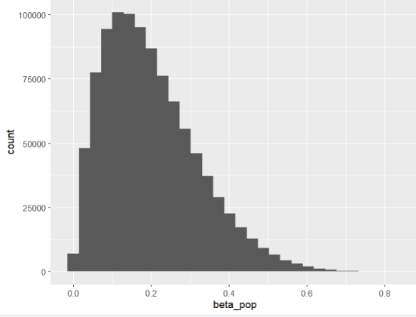
Beta: shape1 = 2, shape2 = 8.
N <- 1000000
beta_pop <- rbeta(N, shape1 = 2, shape2 = 8)
plot_3 <- data.frame(beta_pop) %>%
ggplot(aes(beta_pop))+
geom_histogram()
plot_3

Slide 7
Creating One Sample
We randomly sample 100 data points from the population of the normal distribution to create our sample then compute the mean.
n <- 100
one_sample <- sample(normal_pop, n)
one_sample_mean <- mean(one_sample)
one_sample_mean
Output:

Slide 8
Creating a Sampling Distribution of the Mean
What is a "statistic"?: A statistic is a numerical value or measure that summarizes some aspect of a sample. (i.e., mean, median, sample standard deviation... etc.)
Sampling Distribution: it's a distribution of a sample statistic based on all possible simple random samples of the same size from the same population.

Slide 9
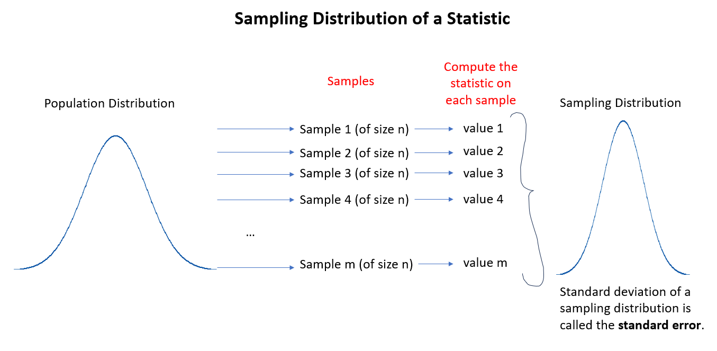

Slide 10
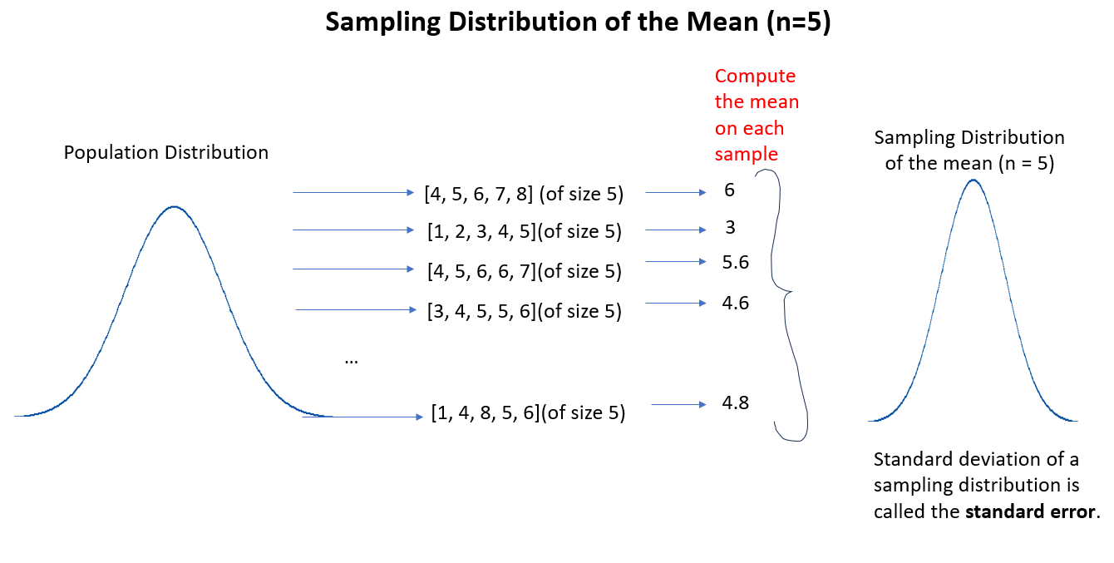

Slide 11
Creating multiple samples and computing the mean of each sample.
get_one_sample_mean <- function(i, population_vector, n) {
one_sample <- sample(population_vector, n)
one_sample_mean <- mean(one_sample)
return(one_sample_mean)
}
Sampling Distribution of the mean with n = 100.
sampling_distribution <- map_dbl(1:10000, get_one_sample_mean, population_vector= normal_pop, n = 100)

Slide 12
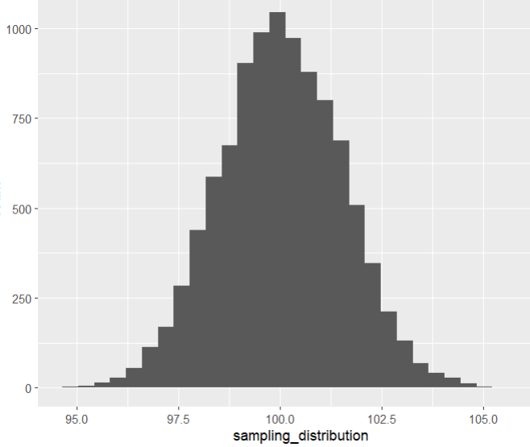
plot_4 <- data.frame(sampling_distribution) %>%
ggplot(aes(sampling_distribution))+
geom_histogram()
plot_4

Slide 13
The standard error is the standard deviation of the sampling distribution.
st_error <- sd(sampling_distribution)
st_error
Output:

